Slide 1
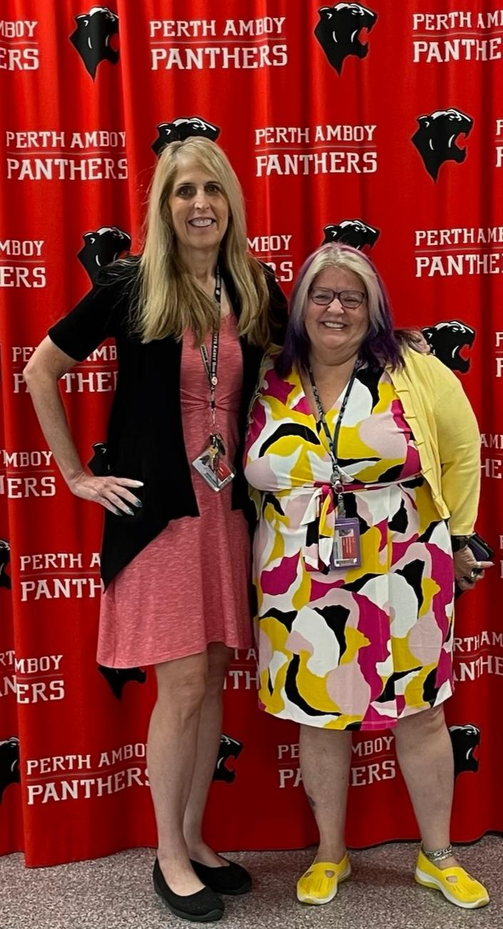
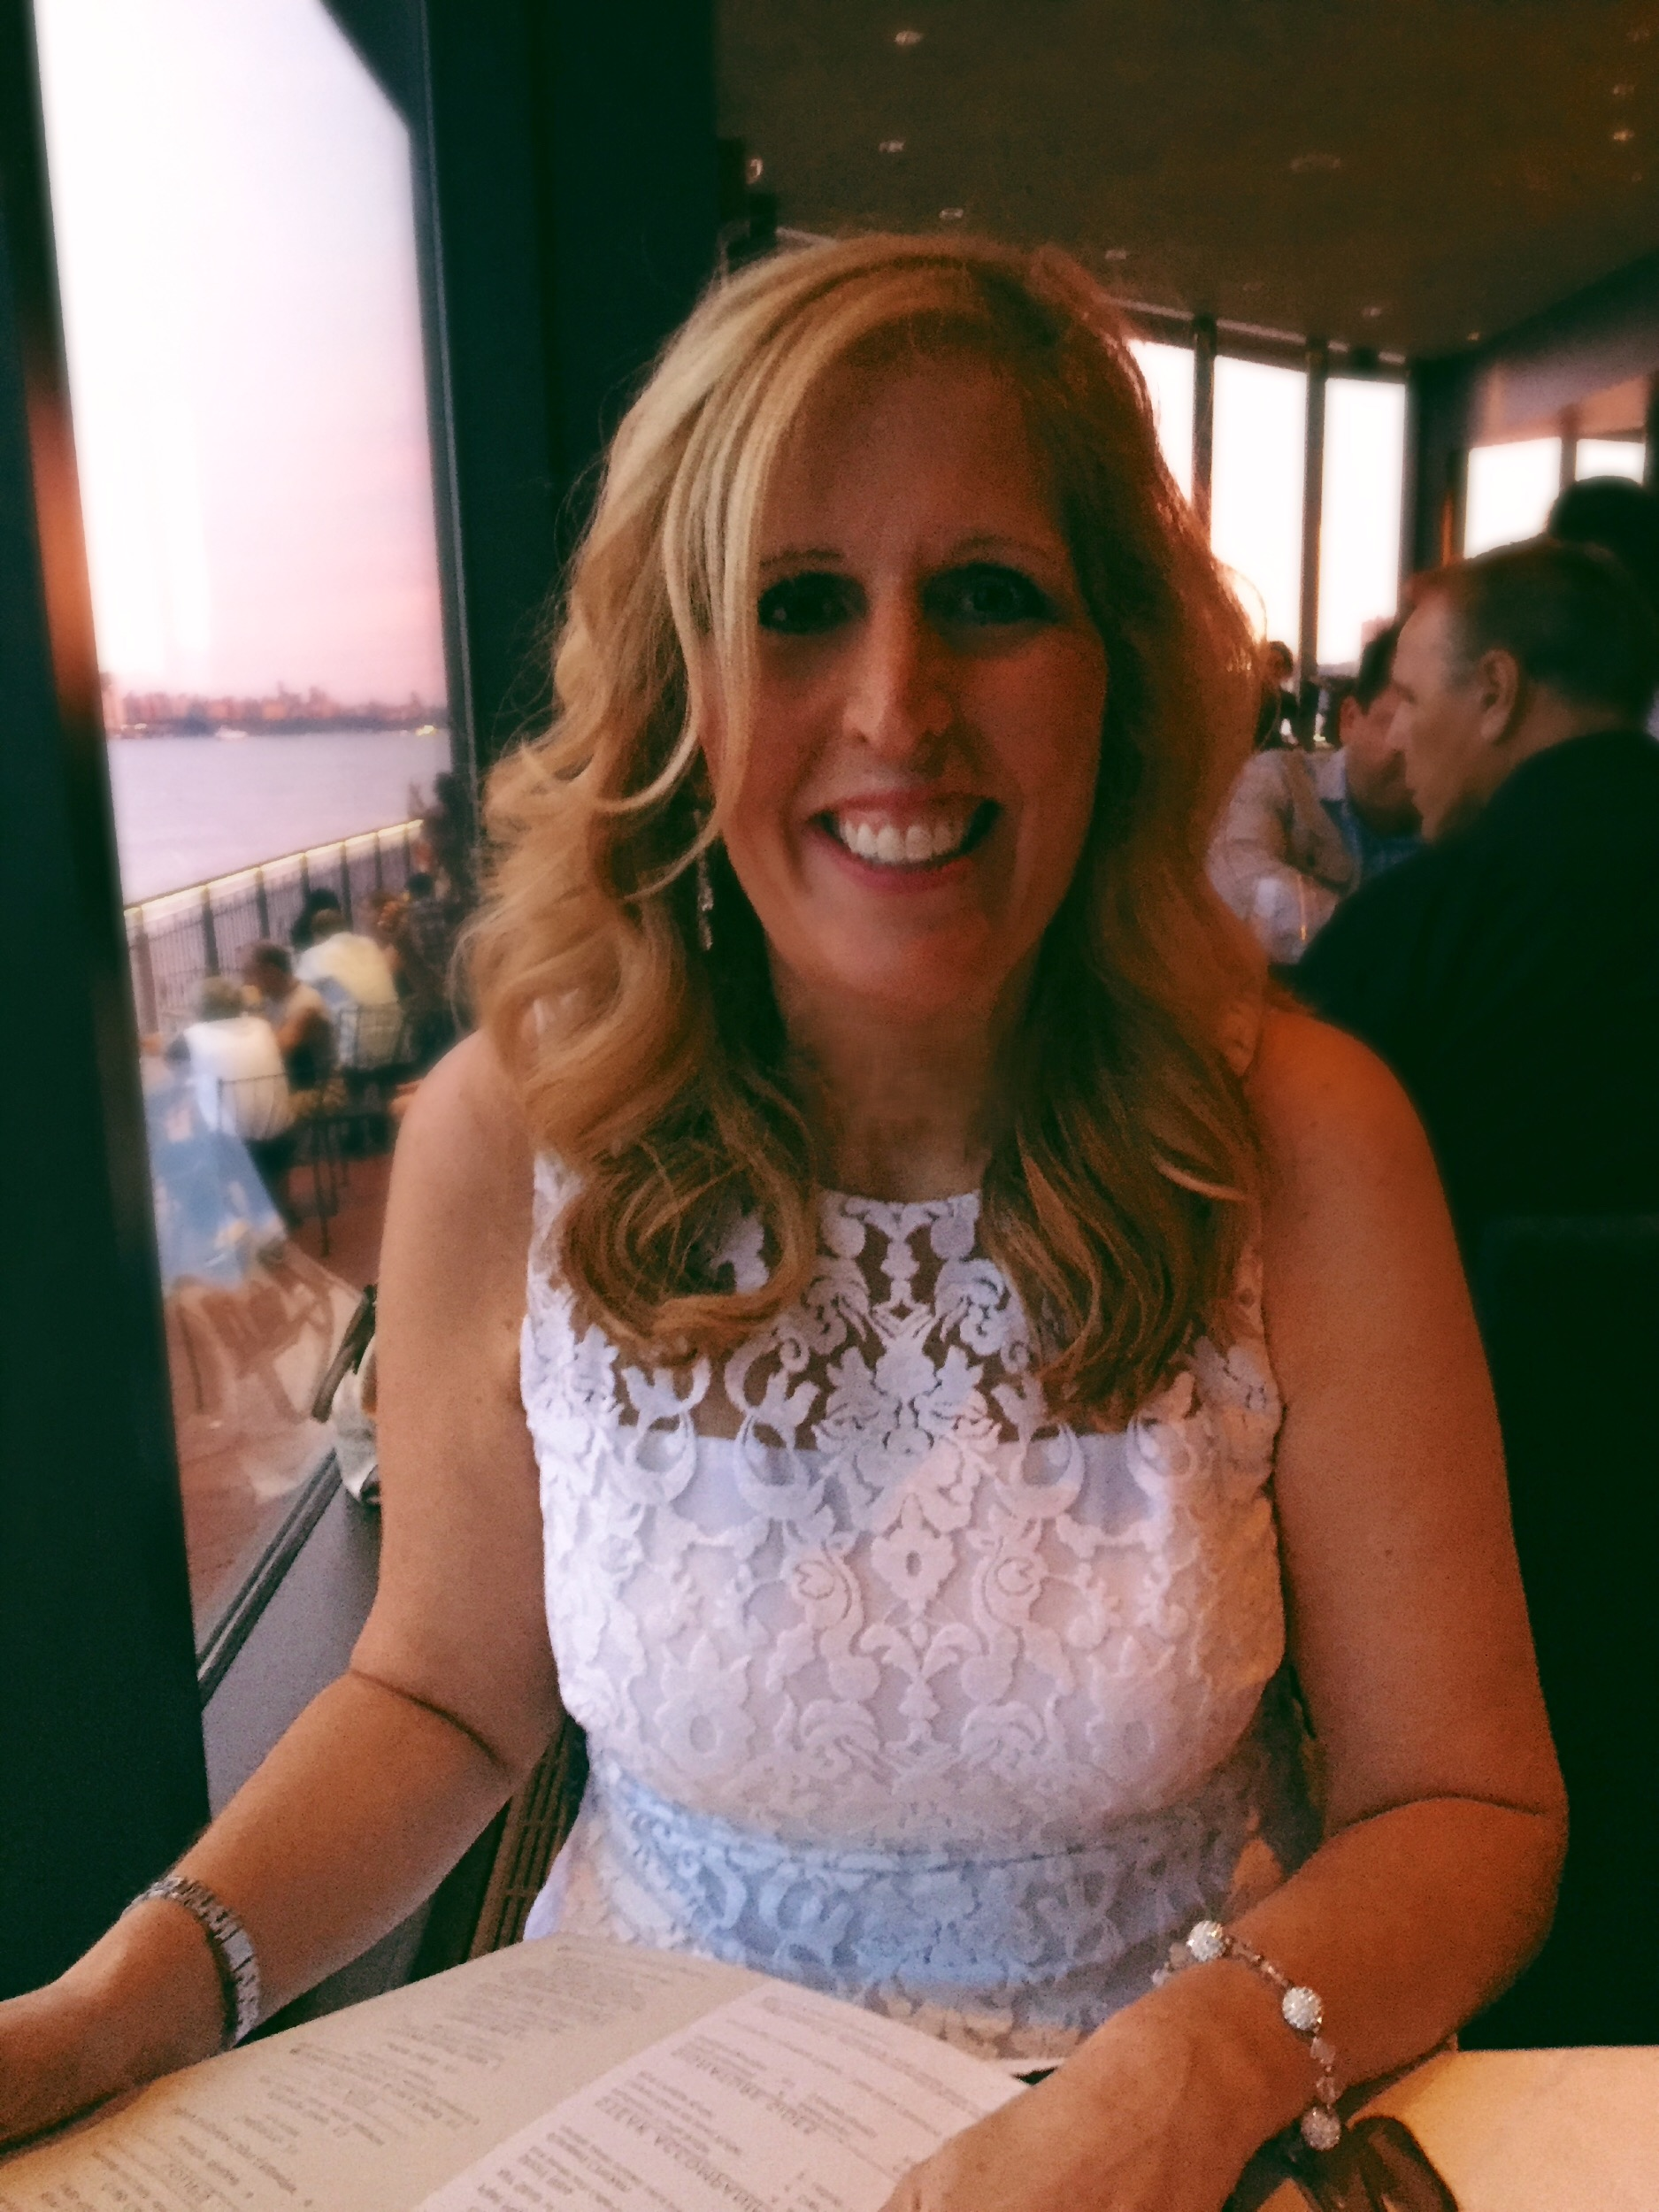
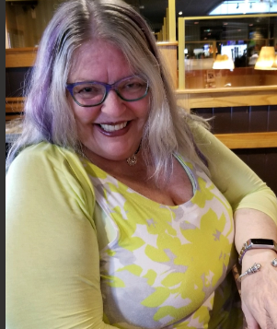
Mrs. Seaman & Ms. Peary
Perth Amboy High School
Freshman Academy
2024-2025 School Year

Slide 2
About Me: Tami Seaman
Professional Information: I am an educator with over 18 years of experience. I have taught classes in Biology, Environmental Science, Physics, Chemistry, Algebra I, Algebra II and Reading. In addition, I have an extensive background working with exceptional learners to help them achieve their full potential. I have taught in Perth Amboy for over 10 years..
Personal Information: I am married and the proud mother of three boys. My oldest son graduated from Brandeis University in Boston, is currently working as a Systems Administrator, and just recently got married.. My other sons attended Rutgers University. The middle son graduated in Exercise Science and is currently working. My youngest son graduated from Rutgers Engineering with a Bachelor of Science in Chemical Engineering as well as with a master’s in Biochemical Engineering. He is currently working at Johnson & Johnson as a Chemical Engineer..

Slide 3
Colleges Attended:
Emory University, Atlanta, GA- Undergraduate Bachelor’s Degree
Seton Hall University, South Orange, NJ- Master’s Degree
Rutgers University- Teaching Degree
Rowan University- Special Education Certification
Kean University- Supervisor Certification
I am a lifelong learner committed to the teaching profession. My goal is to inspire others to learn and be the best that they can be!
"To me there is nothing more fulfilling than knowing that you have made a difference in a child’s life. “

Slide 4
About Me: Ms. Coralie Peary
Professional Information: I am an educator with 20 years of experience. I have taught classes in Biology, Environmental Science, Middle School Science, Middle School Math, and 4th grade. In addition, I have an extensive background working with exceptional learners to help them achieve their full potential. I have taught in Newark for 14 years, Bloomfield for 4 years, and ran a school for a year. My degrees are in Bio/Chem, Masters in Education Administration, and Special Education
Personal Information: I am single, no children, and love animals. I work with animal rescue and love to shop. I am unique and bring many experiences to the classroom. I commute to school 41 miles. I am still in contact with former students from 18 years ago.

Slide 5
Colleges Attended:
Mercer County Community College, West Windsor, New Jersey- Double Undergraduate Bachelor’s Degree(Biology & Chemistry)
Georgian Court University, Lakewood, New Jersey-
Bachelor Degree(Biology with minor in Chemistry &
Special Education Certification
Saint Peters University, Jersey City, New Jersey-
Master’s Degree Education Administration(supervisor/Principal Cert.)
"Creating a brightor future. “

Slide 6
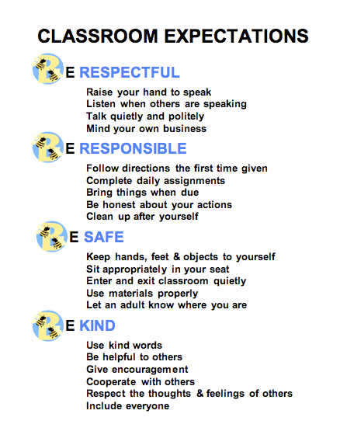
Classroom Expectations

Slide 7
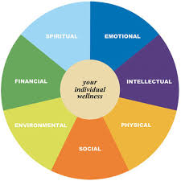
Academic Expectations
“Creating a culture of High Expectations, Student Motivation and Instructional Support
that promotes success for every student”
Communicate Effectively Through
Listening, Speaking and Writing.
Read fluently, critically and with understanding.
Use of technology and various tools to locate, organize and process information from various sources.
Public Speaking, performing and creating to express ideas.
Identifying, Clarifying, and describing issues/problems
Utilizing thinking skills and reasoning strategies.
Analyzing and Solve Problems Effectively by questioning, identifying, observing, hypothesizing, experimenting, and concluding.
BE THE BEST THAT YOU CAN BE!

Slide 8
Things you’ll see in our classroom…..
Do Nows/Exit Slips
Inquiry Based Labs
Direct Instruction
Student Exploration
Social and Emotional Learning
Science and Literacy Practice
Key Words/ Word Morphology
Study Guides
Use of Technology/Research
News/Media
Mnemonics/Analogies
Bulletin Boards/Jam Boards
Technology
Online Interactive Labs
Games
Demonstrations
Cross Curriculum lessons
Differentiated Instruction
Small Group Activities
Whole Group Activities
Individual Activities
Formal and Summative Assessments
Social and Emotional Growth
Reflection
Questioning
Collection of Data/Graphing
Safe Environment
Happy Faces

Slide 9
Biology CP Course
Topics Covered:
Intro to Nature of Science
Characteristics of Life
Large Biological Molecules
DNA, Genes, Mutations
Cellular Reproduction
Sustainable Future
Inheritance
Evolution
Ecology

Slide 10
Classroom Policies (Failure to follow will result in documentation)
Students will come to class consistently and on time
Students will bring their computer charged
Students are in appropriate school uniform (no hoodies or crocs in sports mode.)
Students are not permitted to use Cell Phone during class- place in holder in the beginning of class along with backpack
Students are not allowed to chew gum/eat food during class
Bullying, Cyber-bullying and Cursing are not allowed
Students hand in all work on a timely basis, unless otherwise instructed.
Classroom Discussion/ Participation is encouraged
Take Notes and Stay Focused
Small Group Work Participation and Cooperation
Practice Activity/Lab Work
Respect Others and yourself
Respect Property of others and the school
Stay on Task
Use Technology Responsibly
Explore, Have Fun and Try your best
Ask for help if you don’t understand

Slide 11
Questions/Answers

Slide 12
Grading
Grading is based on accumulated points from both formative and summative assessments such as:
Tests, Quizzes (60%) , Classwork (35%), Homework, Notes (5%)

Slide 13
Our Goals as Teachers
Serve as Mentors
Instill the Love of Learning
Keep Students Engaged
Constantly seeking out opportunities for Professional Development
Show student growth in learning and social development
Create an accepting and safe environment
Increase Interest in the Sciences
Create Responsible Citizens of the World
Prepare students for college and professional success!

Slide 14
Parent Involvement Needed
Parents/Guardians as Models
Parents/guardians have a tremendous impact on children's behavior. What they observe in adults becomes a standard of behavior.
Create an appropriate study environment
Check Infinite Campus to monitor to monitor student progress
Create a predictable routine if possible
Take time to listen or talk to your child about how their day is going
Make student eats a well balanced diet
Be a partner with your child and child’s teacher
Serve as a role model for your student
Give your child love and support

Slide 15
Contact Information
We can be reached via email
Our email addresses are:
corapeary@paps.net and Tamiseaman@paps.net

